Slide 1
Election of 1864
The American Battlefield Trust

Slide 2
Inquiry Question:
What events, actions, and/or ideas helped Lincoln win the presidential election of 1864?
Notes:
Ask students to create a hypothesis of the answer to this question. Have students either discuss in groups their ideas or as a class. Ask students how they produced those hypothesis.

Slide 3
Vocabulary
Federal Government – The central government for the entire country. In the United States each state has its own government, and each state is also a member of the ‘union’ in the country. As a member of the Union all the states and its citizens must abide by the laws of the central or federal government.
Constitution – A document listing the main ideas of how a country is run and organized. The United States Constitution lists how the government works and what rights are allowed to the federal government and citizens.
Compromise – An agreement between two or more people or groups of people. Usually neither side is totally happy, but it is a way to agree on how to move forward.
Territory – land that is part of a country, but not yet organized into a state with laws and representation in the federal government.
Tariff – the cost of goods or services that are traded over a state or national boarder.
Slavery – a human being working in any way without being paid. Usually a person in slavery is also not able to move about freely or control major events in their life.
Notes:
More terms and definitions can be found on the “Glossary of Civil War Terms” page: https://www.battlefields.org/glossary-civil-war-terms

Slide 4
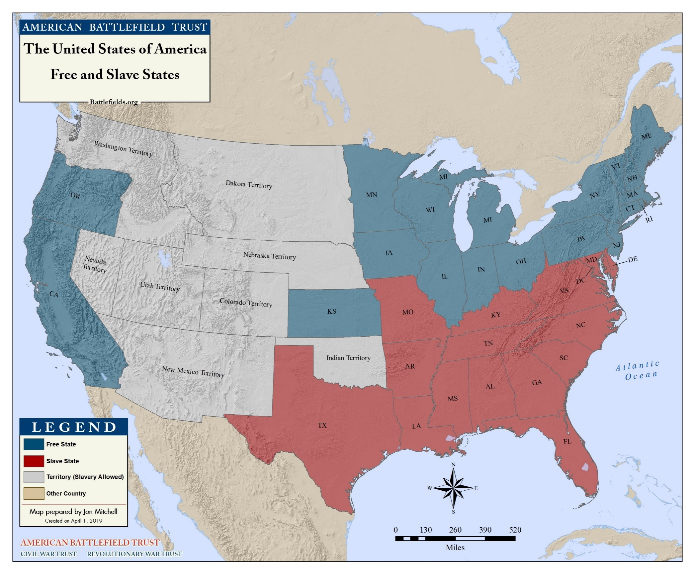
Westward Expansion
Compromise of 1820
Maine = free state
Missouri = slave state
Land west of 36°30′ parallel = free states
Compromise of 1850
Stricter Fugitive Slave Law
Slavery remains in D.C
California = free state
New Mexico and Utah territories can personally rule on free vs. slave status
Texas’s borders = slave state (borders redefined)
Notes:
Slavery, and its continual existence, was debated when new territories and states entered the Union. Each compromise did not definitely answer which territories would allow slavery and which territory would not. With more unclaimed land, this question would continue to be discussed

Slide 5
Slavery…
North | South
Creates competition for white Northern farmers and low-wage workers Gives the South too much economic power Is Morally wrong | Helps manage large plantations at a low cost Gives the South economic power
Notes:
Views on Slavery:
Most northerners did not support emancipation because of moral reasons → most did so because they didn’t want South to become too powerful, too rich, or expand their sphere of influence too far
Most Southerners wanted to continue slavery because slavery’s expansion helped manage large plantations at a low cost and gave the South economic power.

Slide 6
Expanding Slavery…
North | South
Gives the South too much economic power Is morally wrong | Lead to less slave insurrection Contributes to longevity of slavery
Notes:
Expanding Slavery
North believed that if slavery expanded the South would be exponential more economically powerful and is morally wrong
South believed that if slavery expanded than there would be less slave insurrection (since unruly slaves could be shipped to different states) and longevity of the institution (since more people would be invested in slavery)

Slide 7
The War Before the Election of 1864
Despite victories at Gettysburg and Vicksburg, war seemed to have reached a standstill
Enormous casualties from Grant’s Overland Campaign
Sherman failed to take Atlanta in the summer of 1864
Idea of a war for emancipation not universally popular

Slide 8
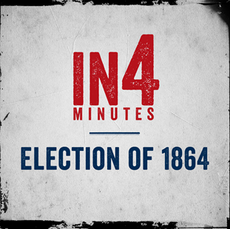
Election of 1864
Activity:
Watch the In4 Video on the Election of 1864.
Why do you think success in the war would have an impact on election results?
Notes:
If Lincoln won the election of 1864, the war would continue, and Emancipation would occur
If McClellan won, then the war would end, and Emancipation would be removed from peace negotiations
This election, and ideology that won, would dictate how new states would enter the union and if slavery would continue in the Untied States

Slide 9
Historical Bias and Perspective
Many of the documents you are about to read are not objective records of what exactly happened during the early 19th century, but rather accounts of how particular people felt about the events going on around them. A good historian, therefore, recognizes that a person’s bias or perspective can consciously or unconsciously shape their opinions in a very different way from someone else. As you read, please keep these questions in mind:
Who is the author?
What are they writing?
Who are they writing for? (Who is their audience?)
When are they writing?
Why are they writing this?

Slide 10
Primary Source

Slide 11
Lincoln on Re-election:
In the summer of 1864, Abraham Lincoln was growing convinced that he would not be re-elected. He wrote the following letter and asked his cabinet to sign their names on the outside, sight unseen, to pledge their commitment to continue the fight to preserve the Union.
“This morning, as for some days past, it seems exceedingly probable that this Administration will not be re-elected. Then it will by my duty to so cooperate with the Government President elect, as to save the Union between the Election and the inauguration; as he will have secured his election on such ground that he cannot possibly save it afterwards.”
Abraham Lincoln, August 23, 1864, Accessed April 26, 2018, https://www.civilwar.org/learn/primary-sources/lincoln-re-election

Slide 12
Democrats vs. Republicans
Main parties competing in 1864: Democrats and Republicans
Both parties in the North generally favored preserving the Union with the rebelling Confederacy, but differed on how to go about it:
Republicans (the party of President Lincoln) = continuing the war to its conclusion and returning the Southern states to the fold that way.
Democrats = working out a peace deal with the Confederacy and sought to restore the Union through non-violent means
Republicans favored Emancipation
Founded as an anti-slavery party (although most were not abolitionist before the war)
Thought emancipation would break the economic power of South
Democrats tended to see unilateral emancipation as a violation of States Rights or planned to scrap it to entice the South back into the Union peacefully

Slide 13
Party Platforms
Parties publish platforms so potential voters get a sense which stance the party takes on certain issues, as well as what the party hopes to accomplish should they be elected to office
Democratic platform
criticized Lincoln for his apparent lack of effort in bringing the South back into the Union diplomatically
letting the war go on for four years
Republicans platform
stuck by the war effort
claimed that the South had to be beaten decisively
slavery, the cause of disunion, needed to be eradicated, or those who had already died would do so in vain

Slide 14
Democratic Party Platform
Key Quotes and Points:
“Resolved, That the aim and object of the Democratic party is to preserve the Federal Union and the rights of the States unimpaired…”
“Resolved, That the direct interference of the military authorities of the United States in the recent elections held in Kentucky, Maryland, Missouri, and Delaware was a shameful violation of the Constitution…”
“Resolved, That this convention does explicitly declare, as the sense of the American people, that after four years of failure to restore the Union by the experiment of war…peace may be restored on the basis of the Federal Union of the States.”
“…The sympathy of the Democratic party is heartily and earnestly extended to the soldiery of our army and sailors of our navy, who are and have been in the field and on the sea under the flag of our country, and, in the events of its attaining power, they will receive all the care, protection, and regard that the brave soldiers and sailors of the republic have so nobly earned.”
Democratic Party Platforms: "1864 Democratic Party Platform," August 29, 1864. Online by Gerhard Peters and John T. Woolley, The American Presidency Project. http://www.presidency.ucsb.edu/ws/?pid=29578.

Slide 15
Republican Party Platform
Key Quotes and Points:
“That as slavery was the cause, and now constitutes the strength of this Rebellion, and as it must be, always and everywhere, hostile to the principles of Republican Government, justice and the National safety demand its utter and complete extirpation from the soil of the Republic.”
“Resolved, That we approve and applaud the practical wisdom, the unselfish patriotism and the unswerving fidelity to the Constitution and the principles of American liberty, with which ABRAHAM LINCOLN has discharged, under circumstances of unparalleled difficulty, the great duties and responsibilities of the Presidential office…”
“Resolved, That we approve the determination of the Government of the United States not to compromise with Rebels, or to offer them any terms of peace, except such as may be based upon an unconditional surrender of their hostility…”
“Resolved, That the Government owes to all men employed in its armies, without regard to distinction of color, the full protection of the laws of war—and that any violation of these laws, or of the usages of civilized nations in time of war, by the Rebels now in arms, should be made the subject of prompt and full redress.”
Republican Party Platforms: "Republican Party Platform of 1864," June 7, 1864. Online by Gerhard Peters and John T. Woolley, The American Presidency Project. http://www.presidency.ucsb.edu/ws/?pid=29621.

Slide 16
Activity
One similarity between both platforms is the respect shown to the soldiers and sailors fighting in the war.
Do you find this to be the one issue both parties agree upon or can you find differences between party statements?
Abolitionists before the war often argued their position on moral grounds.
Does the support for Emancipation in the Republican platform make that same argument to you? Why or why not?
The man credited with writing the Democratic platform was Clement Vallandingham, whom Lincoln had exiled to the Confederacy and later Canada for his open support for secession.
How might this affect the language the platform uses on Lincoln’s record as president?
What does each platform say about how people thought about the progress of the war, and the proximity to victory?

Slide 17
Political Cartoons
Useful to communicate ideas and opinions to as wide an audience as possible
Helpful tools to examine different perspectives on a single issue
Cartoonist’s biases are often readily apparent due to the need to mock and caricature opponents
Contain dialogue as well as artistic depictions

Slide 18
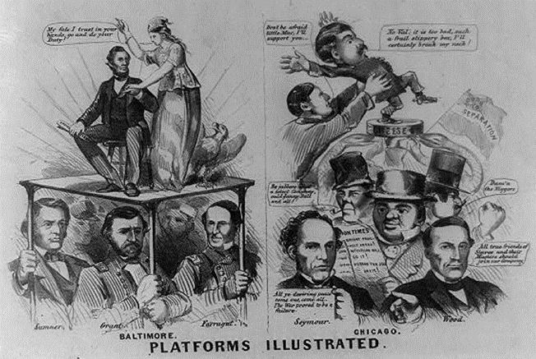
Cartoon #1: Platforms Illustrated
Activity:
Which Party do you think the illustrator favors?
How does he see the war effort progressing?
Look at the way the illustrator depicts Grant and Farragut compared to their former colleague McClellan. How do the former compare to the latter, and what might that say about the author’s views of each side’s records?
“Platforms Illustrated,” 1864. Louis Prang & Co. Lithograph on wove paper. Source: Library of Congress Prints and Photographs Division, accessed April 26, 2018, https://www.loc.gov/resource/cph.3a09828/.

Slide 19
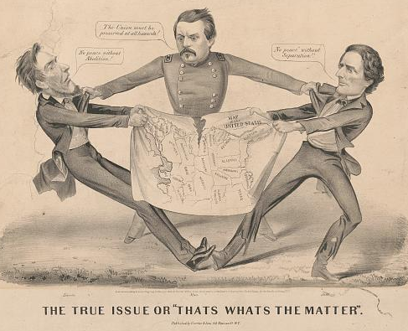
Cartoon #2: The True Issue or “That’s What’s the Matter”
Activity:
How does the author effects of the ongoing war?
How is McClellan depicted compared to Lincoln and Davis?
What do you think this cartoon says about then-Democratic views of Emancipation in 1864?
“The True Issue or ‘That’s Whats the Matter,” 1864. Currier & Ives. Lithograph on wove paper. Source: Library of Congress Prints and Photographs Division, accessed April 26, 2018, https://www.loc.gov/item/2003656580/

Slide 20
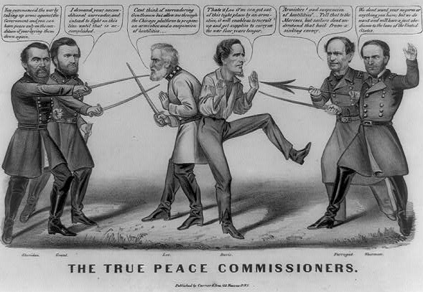
Cartoon #3: The True Peace Commission
Activity:
How does this cartoon depict the progress of the war effort?
In this cartoon, Lee’s dialogue references the 1864 Democratic Platform. What do you think that says about this author’s opinion on preserving the Union through diplomacy, rather than forcing a surrender?
What does Sherman’s dialogue say about this author’s thoughts on emancipation and its connection to the war?
Cameron, John. “The True Peace Commissioners,” 1864. Currier & Ives. Lithograph on wove paper. Source: Library of Congress Prints and Photographs Division, accessed April 26, 2018, https://www.loc.gov/item/2008661660/

Slide 21
Lincoln’s Letter to Major General Sherman:
Major General Sherman,
The State election of Indiana occurs on the 11th. of October, and the loss of it to the friends of the Government would go far towards losing the whole Union cause. The bad effect upon the November election, and especially the giving the State Government to those who will oppose the war in every possible way, are too much to risk, if it can possible be avoided. The draft proceeds, notwithstanding its strong tendency to lose us the State. Indiana is the only important State, voting in October, whose soldiers cannot vote in the field. Any thing you can safely do to let her soldiers, or any part of them, go home and vote at the State election, will be greatly in point. They need not remain for the Presidential election, but may return to you at once. This is, in no sense, an order, but is merely intended to impress you with the importance, to the army itself, of your doing all you safely can, yourself being the judge of what you can safely do. Yours truly
A. Lincoln
Abraham Lincoln to William T. Sherman, September 19, 1864, Teaching American History.org, http://teachingamericanhistory.org/library/document/letter-to-william-t-sherman/

Slide 22
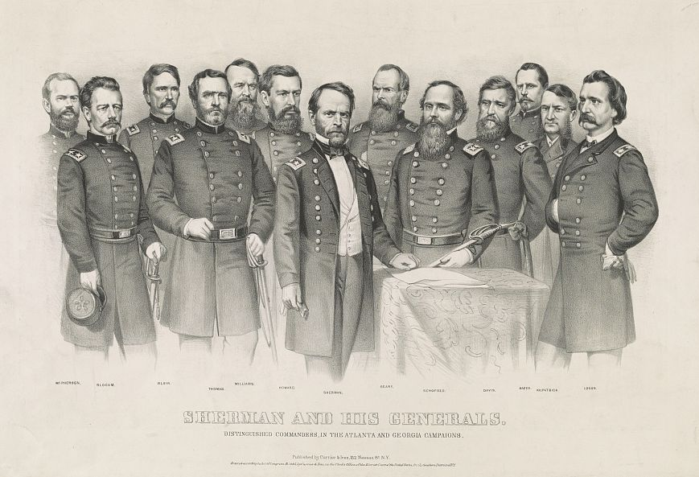
Activity
What do you think this letter reveals about Lincoln’s assumptions on how soldiers would vote if given the chance?
Does the tone of the letter seem to you that Lincoln remains unsure of his chances of reelection?
Based on this letter, how do you think Lincoln views the chance of a Democratic victory in November? What does he mean by “Friends of the government?”
Sherman’s final capture of Atlanta and subsequent March to the Sea campaign was seen as the greatest sign of progress in the war since Grant’s capture of Vicksburg almost a year before. (Library of Congress)

Slide 23
Secondary Source

Slide 24
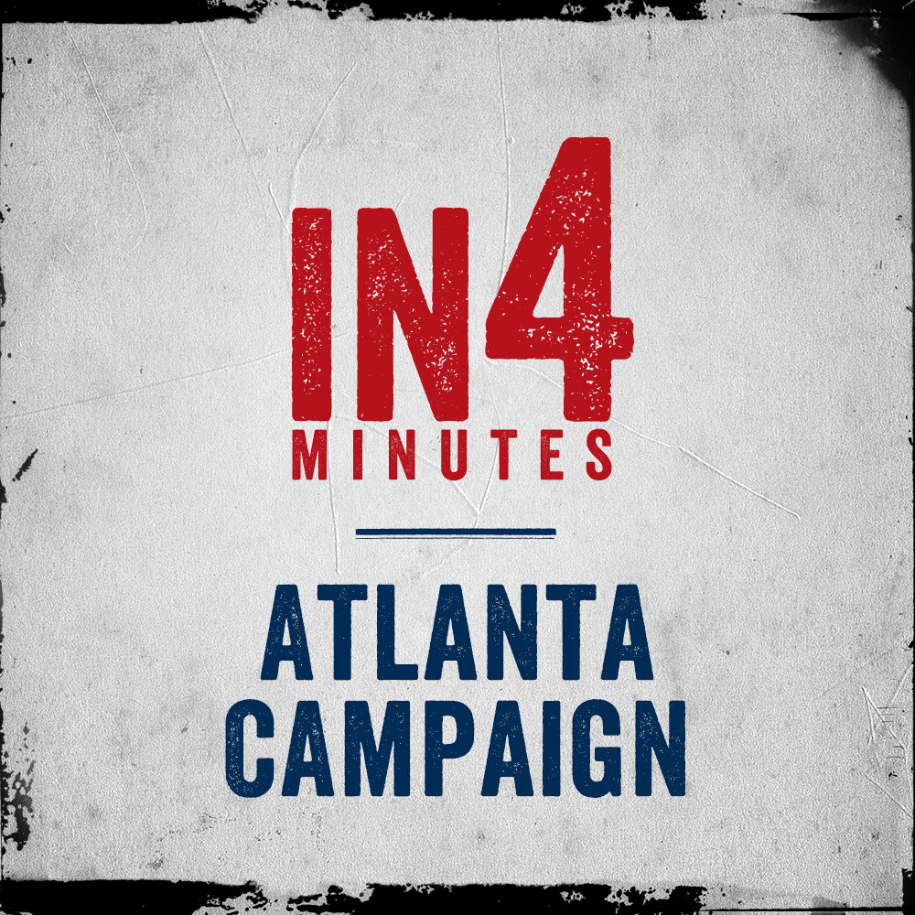
The Atlanta Campaign
Sherman tasked to take Atlanta as the last major city of the Deep South
Only recently took up Grant’s command of the Western Theater
Critical railway hub for the Confederacy
Sherman’s Army frequently engages the cautious Joseph E. Johnston to a stalemate, but fares much better against the aggressive John Bell Hood
Mayor of Atlanta surrenders to Sherman on 2nd of September
Sets the stage for the March to the Sea Campaign
Activity:
Watch the In4 Video for the Atlanta Campaign.
Why do you think railroads were so important to control during the Civil War?

Slide 25
Discussion Questions
What limitations in 1864 do you think prevented either Lincoln or his Democratic opponents from properly predicting the outcome of the election?
Why do you think the Republicans managed to overcome the divides within their party while the Democrats could not?
One of the greatest miscalculations the Democrats made during their 1864 Campaign was the level of support for finishing the war, including emancipation, amongst their own voters. What do you think happened that might have turned people’s minds about the war?
Notes:
Read the secondary sources in the packet and use these discussion questions as a jumping off point for a class-wide discussion. Focus on the importance of the election, what the candidate's platforms were, and how the outcome of the election would have effected the United States.

Slide 26
Inquiry Question:
What events, actions, and/or ideas helped Lincoln win the presidential election of 1864?
Notes:
Discuss with the students on whether their hypothesis were correct or not. Discuss what the students learned from their primary and secondary sources.

